Slide 1
Blind Motion with Text

Slide 2
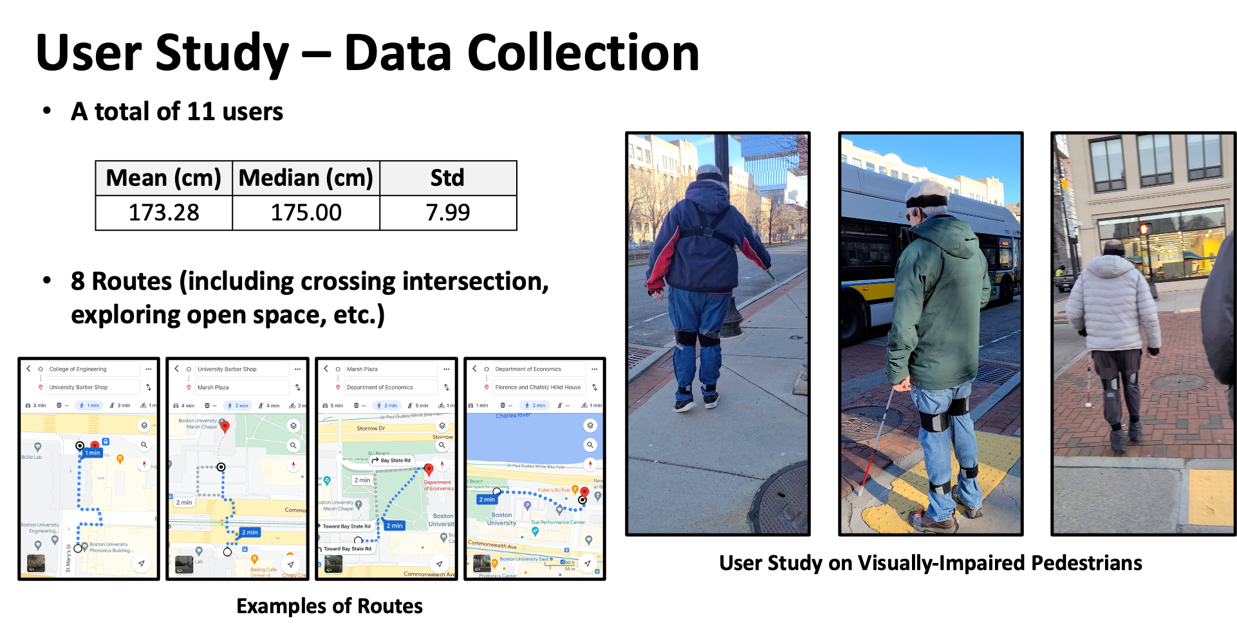

Slide 3
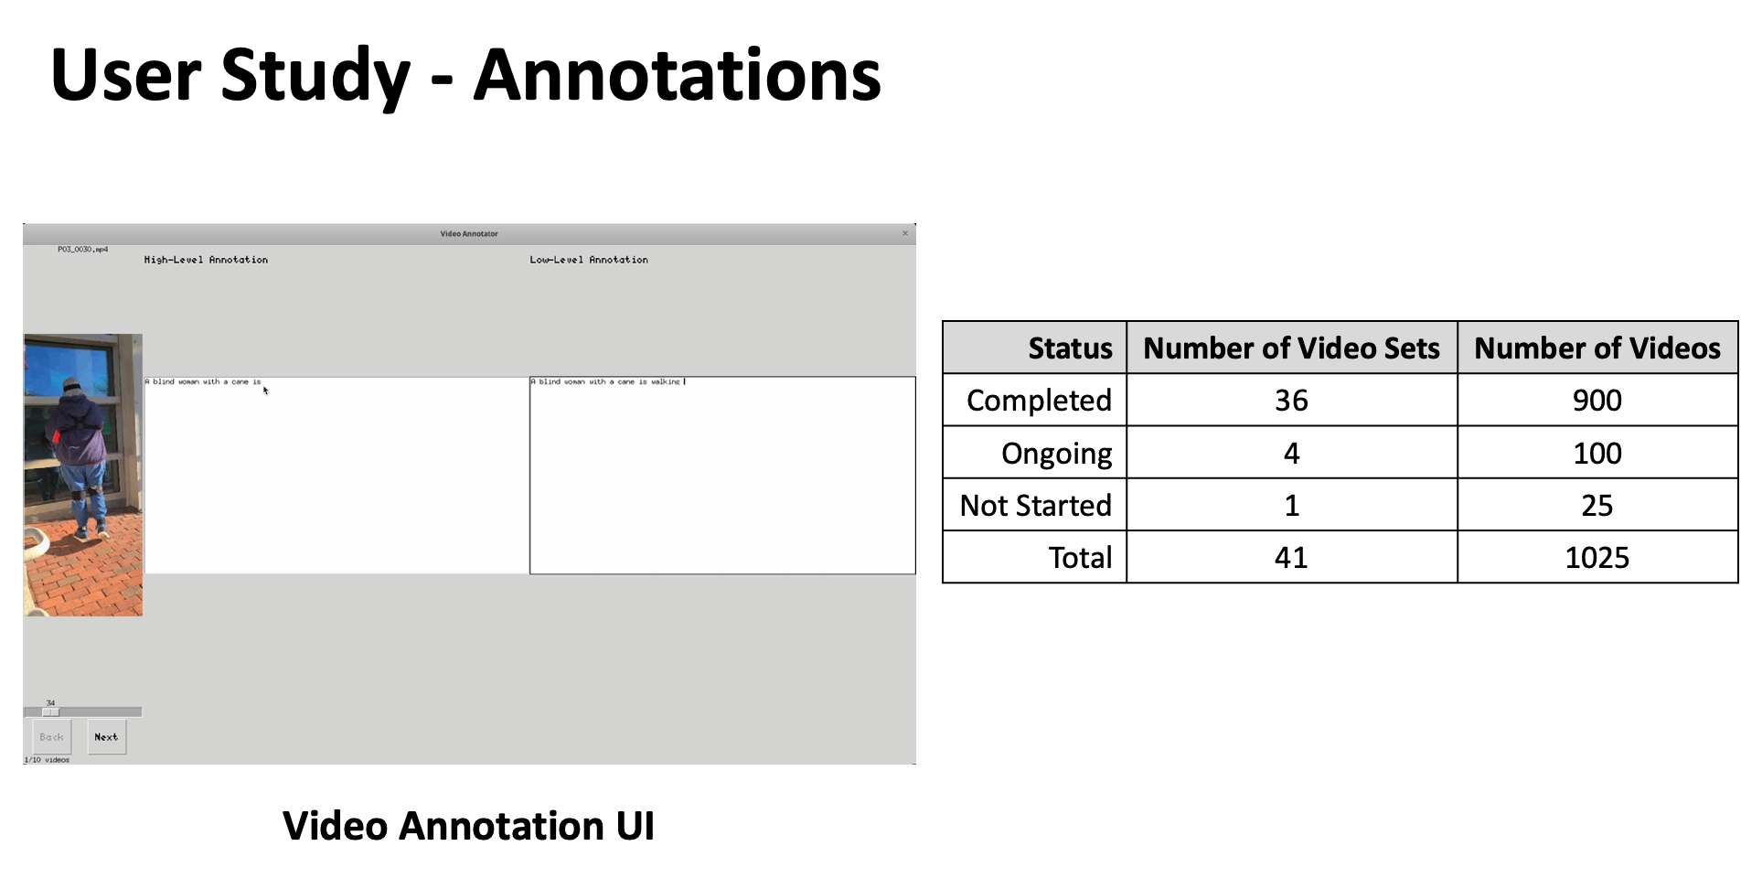
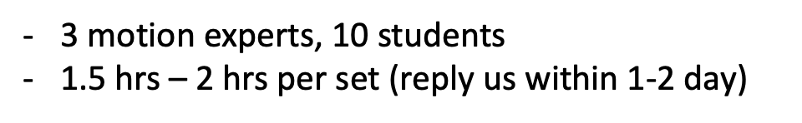

Slide 4
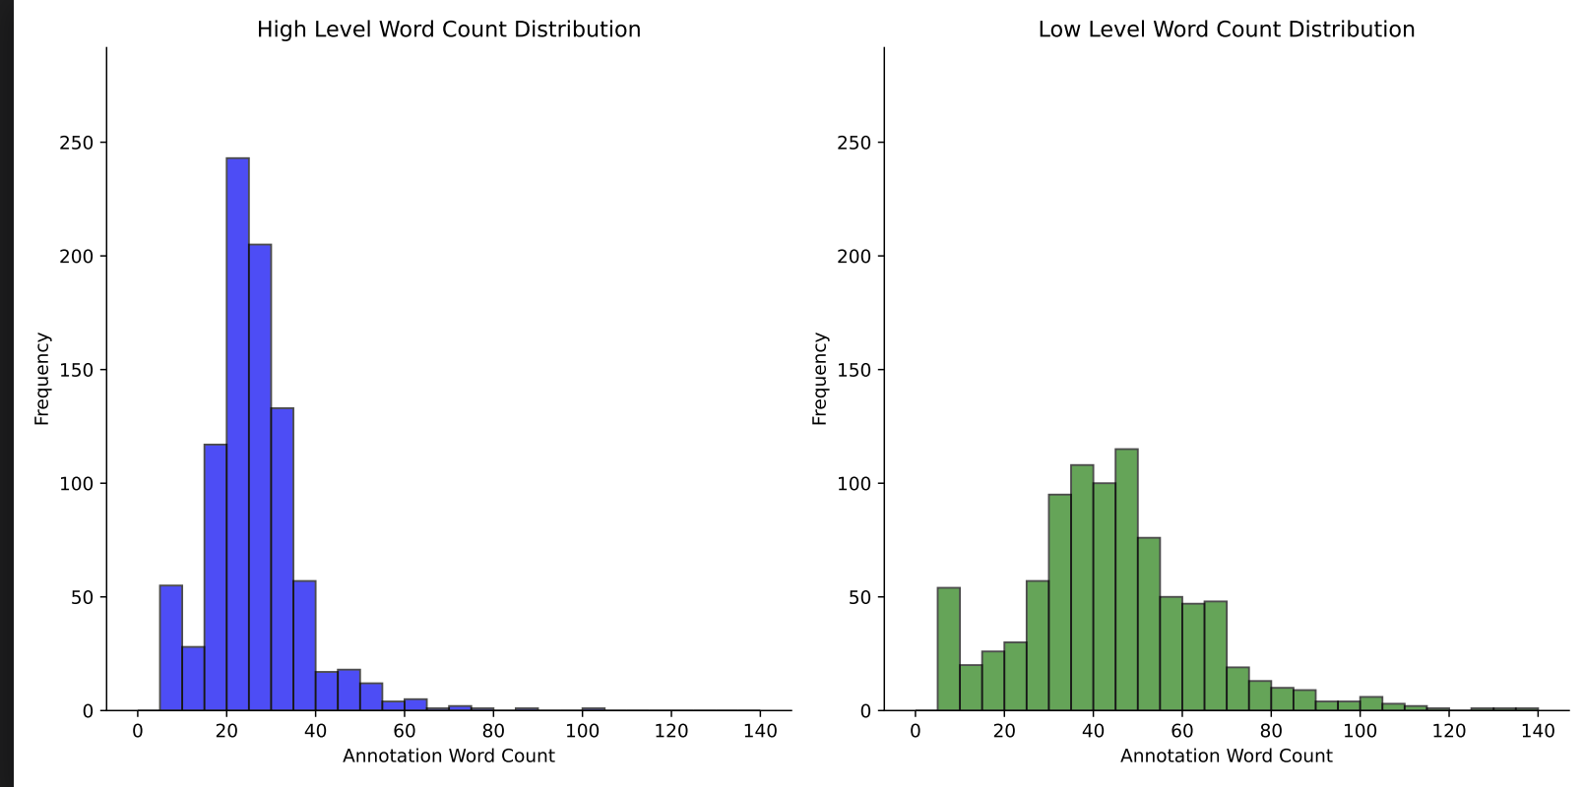

Slide 5
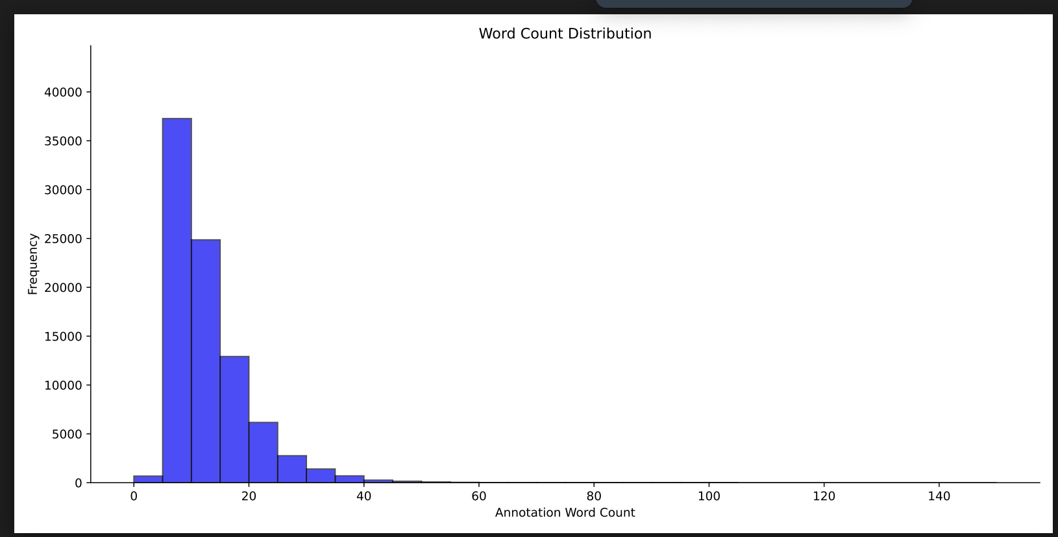

Slide 6
VAE + Text Encoder - Quantitative Example
XYZ dimension | Motion History + Text Conditioned Motion Prediction
 | Train set | Test set | Language Model | APD | ADE | FDE
VAE + Text | HumanML3D | Ours | llama2 | 13.88 | 0.98 | 1.04
VAE + Text | Ours | Ours | llama2 | 8.34 | 0.55 | 0.64
VAE + Text | HumanML3D | HumanML3D | llama2 | 14.13 | 0.86 | 1.01
VAE + Text | Ours | HumanML3D | llama2 | 8.38 | 1.09 | 1.15
Notes:
Per joints
Per seconds
Only text (llm encoder)

Slide 7
GPT Models
 | Text-to-Motion baselines
 | Train set | Test set | R Precision(GT-Comp) |  | Diversity(GT-Comp) |  | Multimodality
text-to-motion | HumanML3D | Ours
text-to-motion | Ours | Ours | 0.2 | 0.35 | 6.14 | 6.57 | 1.5222
text-to-motion | HumanML3D+Ours | Ours
MotionGPT | HumanML3D | Ours
MotionGPT | Ours | Ours
MotionGPT | HumanML3D+Ours | Ours
TM2T (ECCV 2022) | HumanML3D+Ours | Ours
T2M-GPT (CVPR 2023) | HumanML3D+Ours | Ours
MDM (ICLR 2023) | HumanML3D+Ours | Ours
T2M-GPT (CVPR 2023) | HumanML3D | Ours
T2M-GPT (CVPR 2023) | Ours | Ours

Slide 8
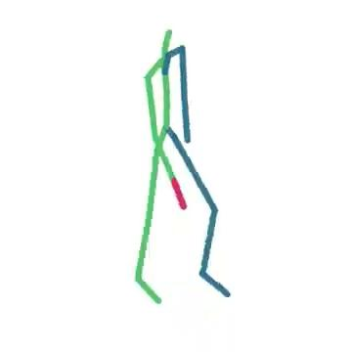
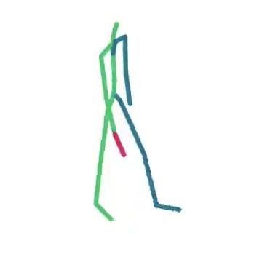
VAE + Text Encoder - Qualitative Example
Ground Truth
Prediction

Slide 9
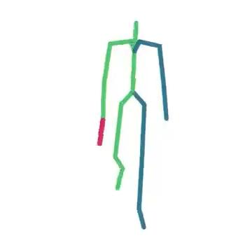
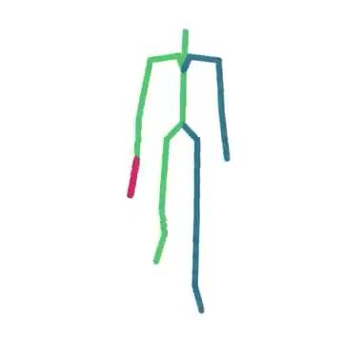
VAE + Text Encoder - Qualitative Example
We should add loss for controllable motion prediction (ex. cane joints)
Ground Truth
Prediction

